Slide 1
Module 2: Development & Management Tools

Slide 3
Agenda
SQL Server Data Tools
SQL Server Management Studio
Command Line Tools for Management

Slide 4
SQL Server Data Tools (SSDT)
Introduced in SQL Server 2012.
Allows for development of projects related to SQL Server services. Such as Reporting Services, Analysis Services, and Integration Services.
Decoupled from SQL Server binaries to allow for easy of management and upgradeability.
Requires Visual Studio to run.
Notes:
https://docs.microsoft.com/en-us/sql/ssdt/download-sql-server-data-tools-ssdt?view=sql-server-2017
SSDT for Visual Studio 2012
SSDT for Visual Studio 2015
SSDT for Visual Studio 2017
SSDT for Visual Studio 2019

Slide 5
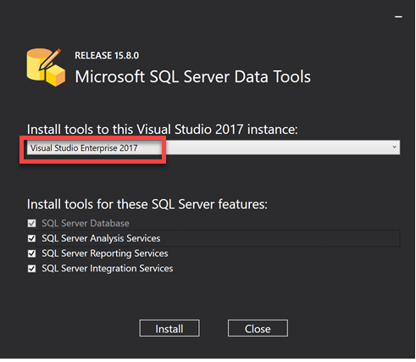
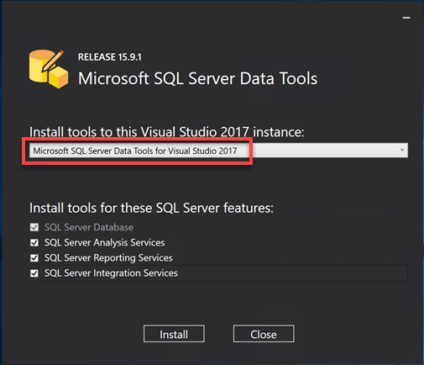
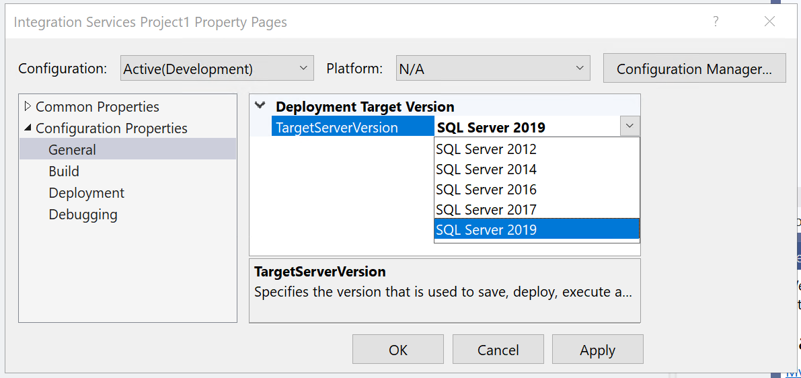
SSDT for Visual Studio 2017
Standalone SSDT
Visual Studio 2017 bundled
Can install VS project templates to existing VS instance
Can target SSIS 2012 to 2019
Notes:
$download_path = "C:\temp"
#------------------------
#must be performed online
if (!(Test-path $download_path)){MKDIR $download_path |out-null}
$vs_sql = "https://download.visualstudio.microsoft.com/download/pr/62217af9-22f9-4f7d-add2-790c8a5b2ba5/a94d810203e4ea378ad2c99cc76f9ff7/vs_sql.exe"
$ssdt_setup="https://download.microsoft.com/download/5/A/D/5AD18EB8-7A35-4296-9364-03CA17E19737/SSDT-Setup-ENU.exe"
$vs_sql_exe = (Join-Path -Path $download_path -ChildPath "vs_sql.exe")
$ssdt_setup_exe = (Join-Path -Path $download_path -ChildPath "SSDT-Setup-ENU.exe")
Invoke-WebRequest -Uri $vs_sql -OutFile $vs_sql_exe
Invoke-WebRequest -Uri $ssdt_setup -OutFile $ssdt_setup_exe
#must be online
&$vs_sql_exe --layout $download_path --lang en-us
#----------------------------------
#Can be performed offline
#install the VS2017 Shell and SQL Server Data Project.
&$vs_sql_exe --NoWeb
&$ssdt_setup_exe /INSTALLALL /passive
#&$ssdt_setup_exe /INSTALLALL[:vsinstances] /passive

Slide 6
SSDT for Visual Studio 2019
No more standalone SSDT installation
Install Visual Studio Community Edition
SQL Server Data Tools (allows for creation of Database Project)
Install Visual Studio Extensions
Can Target SSIS 2012 to 2019
Visual Studio Extension Name
SQL Server Integration Services Projects
Microsoft Analysis Services Projects
Microsoft Reporting Services Projects
Notes:
If you already have Visual Studio Enterprise or Professional Edition, then you do not need Community edition.
Ensure you have selected SQL Server Data tools as a features during Visual Studio installation, This will install the necessary SQL Server .net assemblies and the SQL Server Database Project Template.
To uninstall Visual Studio 2019 Extensions
C:\Program Files (x86)\Microsoft Visual Studio\2019\Enterprise\Common7\IDE\VSIXInstaller.exe
Direct Download Links
https://visualstudio.microsoft.com/thank-you-downloading-visual-studio/?sku=community&rel=16&utm_medium=microsoft&utm_source=docs.microsoft.com&utm_campaign=offline+install&utm_content=download+vs2019
* If you install Visual Studio Community, you must activate it within 30 days of installation. This requires an internet connection.
* Full installation path is less than 80 characters.
vs_community.exe --layout c:\vslayout --lang en-US
https://ssis.gallerycdn.vsassets.io/extensions/ssis/sqlserverintegrationservicesprojects/3.1/1562574939108/Microsoft.DataTools.IntegrationServices.exe
https://probitools.gallerycdn.vsassets.io/extensions/probitools/microsoftanalysisservicesmodelingprojects/2.8.17/1563562300275/Microsoft.DataTools.AnalysisServices.vsix
https://probitools.gallerycdn.vsassets.io/extensions/probitools/microsoftreportprojectsforvisualstudio/2.5.9/1563316801704/Microsoft.DataTools.ReportingServices.vsix

Slide 7
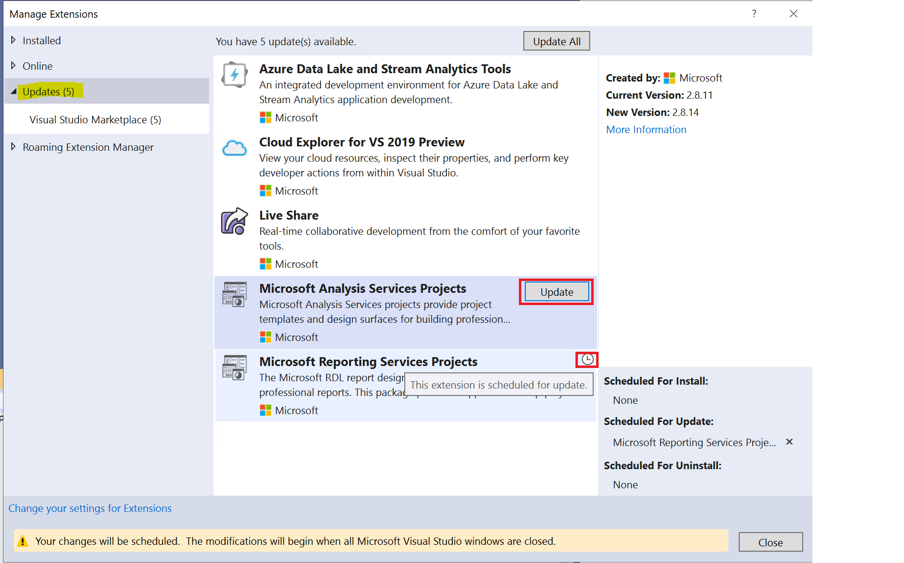
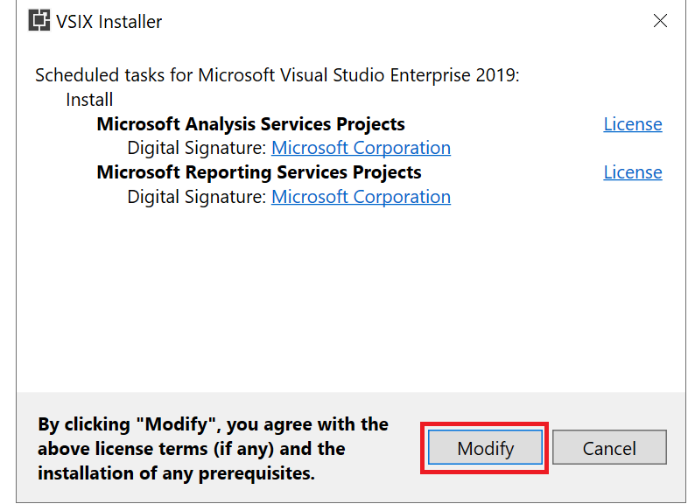
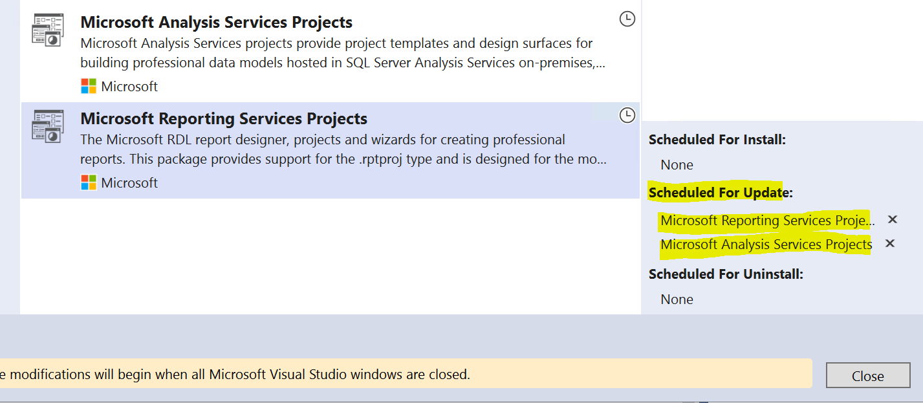
SSDT 2019 - Updates
Check/Apply any Extension Updates

Slide 8
Visual Studio 2022
SQL Integration Services project is not supported in Visual Studio 2022.

Slide 9
SSDT Walkthrough
Demo

Slide 10
SQL Server Management Studio (SSMS)
Provides ability to deploy SSIS Catalog DB.
Provides ability to schedule packages via SQL Server Agent.
Configure and setup proxy accounts for execution.
View current executions & history vis SSIS Catalog DB reports.
Start/Stop Packages.
Notes:
Adding Visual Studio Extensions
Solution & Projects
SSIS Toolbox
SSIS Menus – Variables , Build, Debug, Extensions
Navigation
Properties Pane

Slide 11
SSMS Walkthrough
Demo
Notes:
SSISDB Packages & Dashboard
MSDB Packages
Connecting to Integration Services

Slide 12
dtutil.exe
Command line tool used to manage packages
copy, move, delete, or verify the existence of a package
Manage SSIS package stored in/on:
/DTS - package stored in SSIS package store
/SQL - package stored in msdb
/FILE - package stored on file system
Notes:
https://docs.microsoft.com/en-us/sql/integration-services/dtutil-utility?view=sql-server-2017
Export packages from MSDB to file (0 value strips Strips sensitive information). Notice the package does not end in .dtsx
dtutil /SQL "maintenance plans\backup" /ENCRYPT FILE;c:\temp\mkpkg.dtsx;0
Copy from File to MSDB
dtutil /FILE c:\temp\mkpkg.dtsx /COPY SQL;"maintenance plans\backup2“

Slide 13
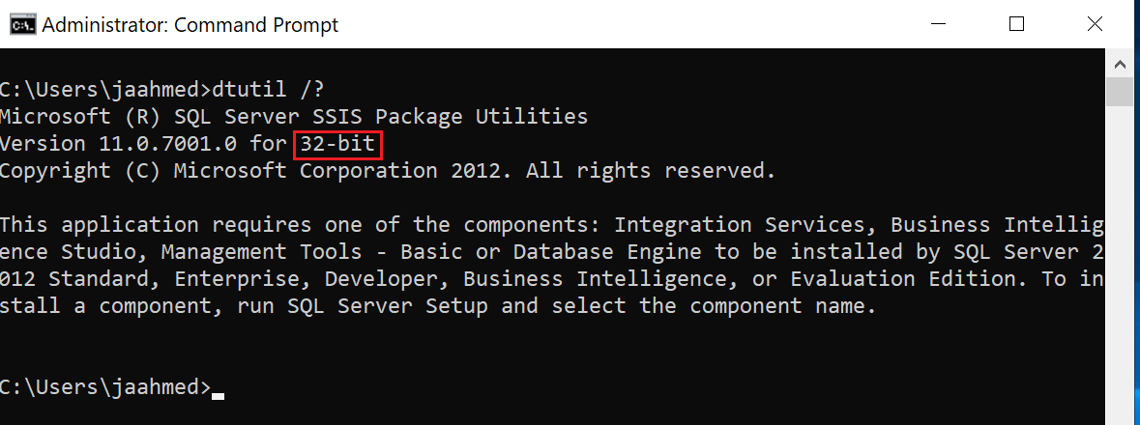
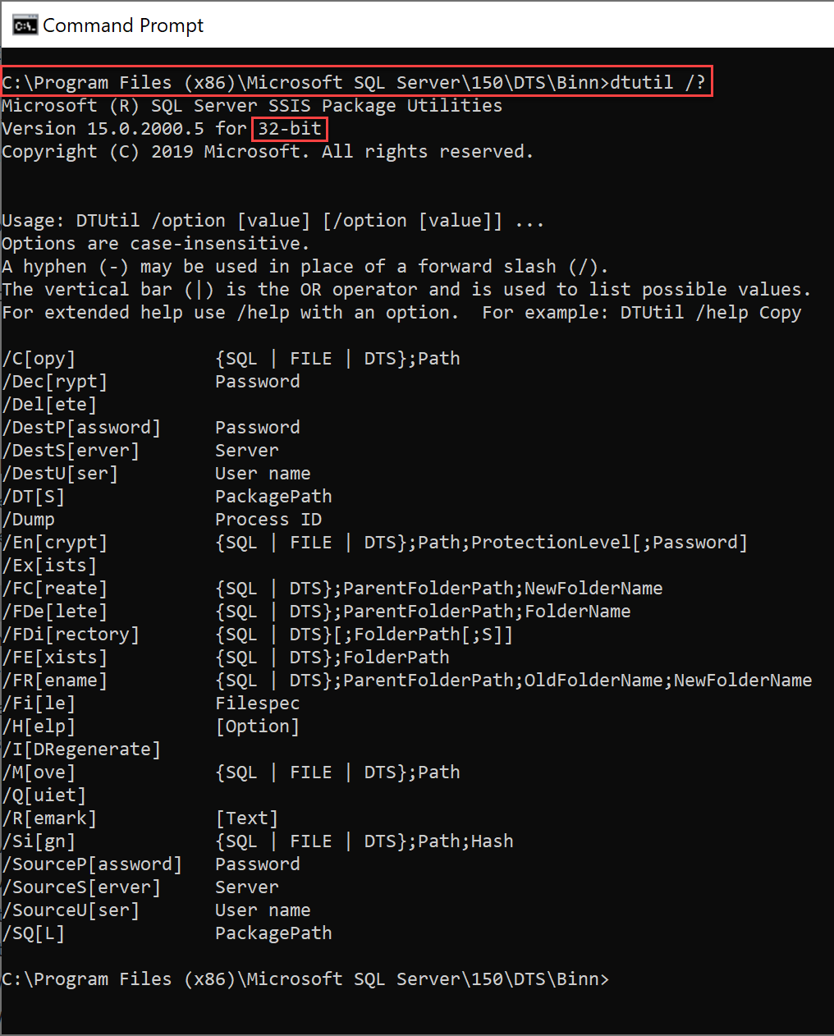
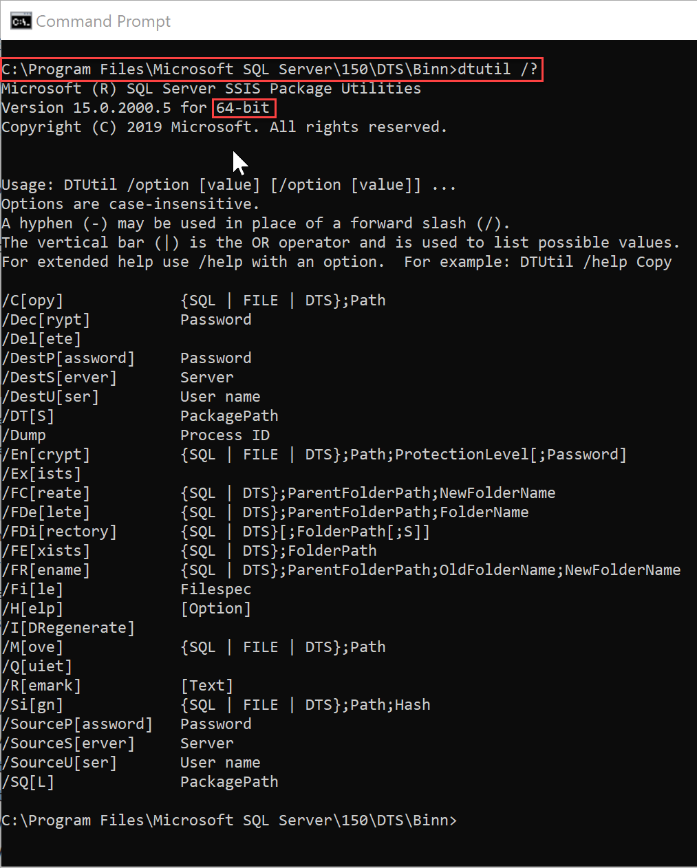
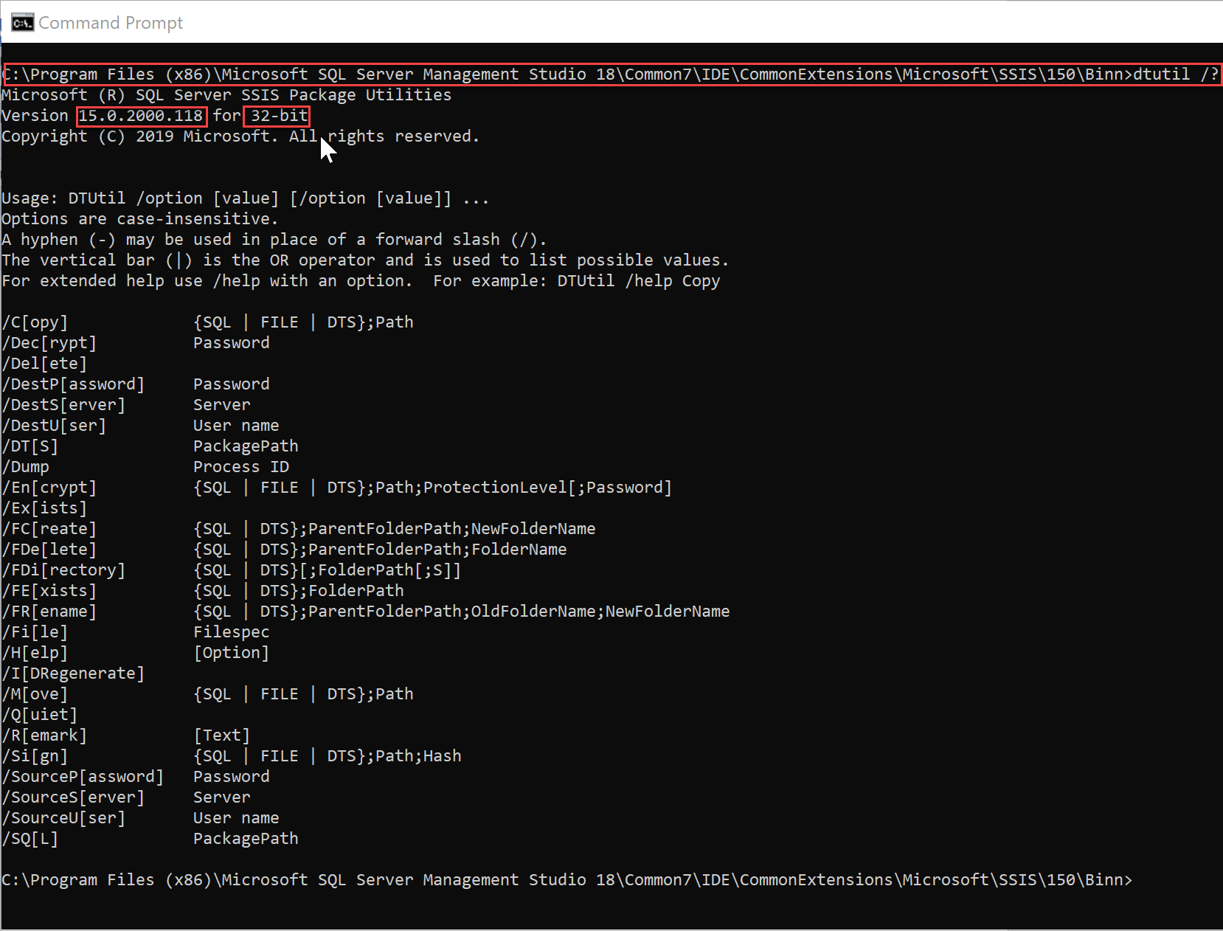
dtutil.exe 32-bit vs 64-bit
Use the 64-bit version
Version | Executable Location
64-bit | C:\Program Files\Microsoft SQL Server\150\DTS\Binn
32-bit | C:\ Program Files(x86)\Microsoft SQL Server\150\DTS\Binn
 | C:\Program Files (x86)\Microsoft SQL Server Management Studio 18\Common7\IDE\CommonExtensions\Microsoft\SSIS\150\Binn\
Notes:
https://docs.microsoft.com/en-us/sql/integration-services/dtutil-utility?view=sql-server-2017
https://support.microsoft.com/en-us/help/906562/how-to-use-the-dtutil-utility-dtutil-exe-to-set-the-protection-level-o
Note: the 32-bit version did not work even after installing these three options:
- “Client Tools Connectivity”
- “Client Tools SDK”
- “Client Tool Backward Compatibility”
You will need to change to the 64-bit folder location and then run the 64-bit dtutil from there then it will work.

Slide 14
dtexec.exe
Command line tool used to execute a package from
.ispac project file
.dtsx File system
Msdb
Ssisdb
Command line arguments used to configure parameters, connections, properties, variables, logging for execution
Temporarily upgrades older packages for execution (but not saved)
“SQL Server Integration Services Package” SQL Job Step will call this executable to run the package
Notes:
https://docs.microsoft.com/en-us/sql/integration-services/packages/dtexec-utility?view=sql-server-2017
Dtexec.exe Command line arguments stored in [command] of msdb.dbo.sysjobsteps for SQL Agent Job Step.
--Job Steps that call SSIS Packages.
select job_name=j.name, js.step_id,step_name=js.step_name, js.subsystem, js.command
from msdb.dbo.sysjobs j
join msdb.dbo.sysjobsteps js on j.job_id=js.job_id
where js.subsystem='SSIS'

Slide 15
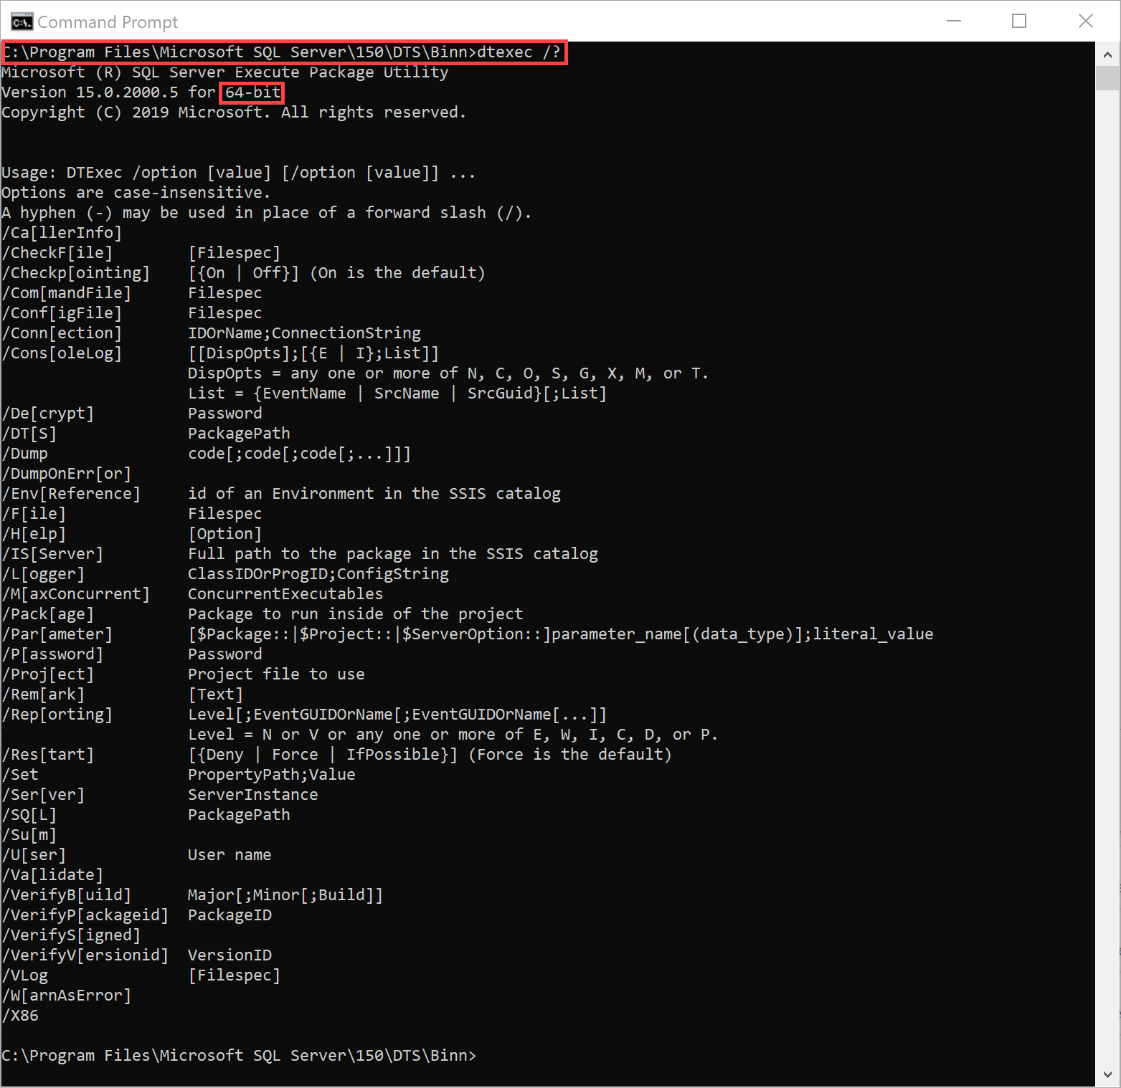
dtexec.exe 32-bit vs 64-bit
to install 32-bit , you must install Client Tools or SQL Server Data Tools (SSDT)
Version | Executable Location
64-bit | C:\Program Files\Microsoft SQL Server\150\DTS\Binn\
32-bit | C:\Program Files (x86)\Microsoft SQL Server\150\DTS\Binn\
 | C:\Program Files (x86)\Microsoft SQL Server Management Studio 18\Common7\IDE\CommonExtensions\Microsoft\SSIS\150\Binn\
Notes:
https://docs.microsoft.com/en-us/sql/integration-services/packages/dtexec-utility?view=sql-server-2017

Slide 16
dtexec.exe - Exit Codes
Dtexec returns exit code
exit code is used to populate the ERRORLEVEL variable
Exit Code Value | Description
0 | The package executed successfully
1 | The package failed.
3 | The package was canceled by the user.
4 | The utility was unable to locate the requested package. The package was not found.
5 | The utility was unable to load the requested package. The package could not be loaded.
6 | The utility encountered an internal error of syntactic or semantic errors in the command line.

Slide 17
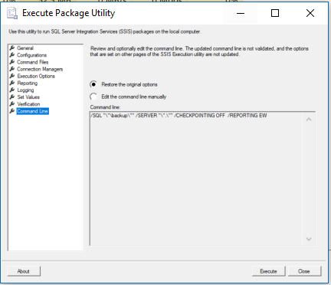
dtexecUI.exe
GUI to build command line argument for dtexec.exe
can also invoke Utility is 32-bit only
Execute button will start
call will dtexec.exe 32-bit.
Version | Executable Location
32-bit | C:\Program Files (x86)\Microsoft SQL Server Management Studio 18\Common7\IDE\CommonExtensions\Microsoft\SSIS\150\Binn\
Notes:
https://docs.microsoft.com/en-us/sql/integration-services/packages/execute-package-utility-dtexecui-ui-reference?view=sql-server-2017
Since the dtexecUI.exe is 32-bit only, then any packages it execute will be using 32-bit version of dtexec.exe
This tool is used to build the parameter and then you can call the 64-bit dtexec.exe manually.

Slide 18
Getting to know SSDT
Lab 2

Slide 19
Questions?
Can you run SSDT without Visual Studio?
No, it is an addon for Visual Studio. However you do not require full version of visual studio.
Where can we see the status of SSIS packages on your server?
Look at SSIS Catalog DB Dashboard.
How can we change version of the SSIS package?
On the properties of the project go to properties > target server version.

